Slide 1
Java Workshop 11 – Exceptions and the Stack
This entire workshop was basically stolen from Sean Zammit
Ben Schwarz

Slide 2


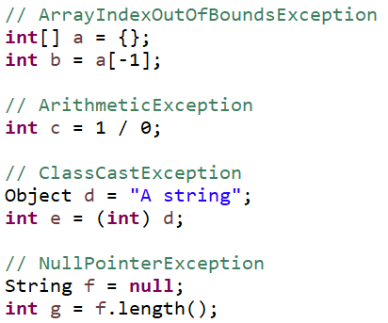
What is an Exception?
Exceptions are:
Errors
Encountered after the program is built, as it runs
Fatal unless explicitly handled by the program
If you do SDD, they’re almost identical to runtime errors. However, the difference is that while Java can and will throw an exception if you do something it can’t handle, the program can also manually throw exceptions.
Some common exceptions:

Slide 3
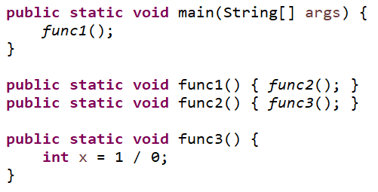
The Stack (briefly)
Consider the code on the right, in which a series of nested functions execute.
Program execution begins in main Stack: [main]
main calls func1 Stack: [func1, main]
func1 calls func2 Stack: [func2, func1, main]
func2 calls func3 Stack: [func3, func2, func1, main]
So the stack stores the sequence of calls.

Slide 4
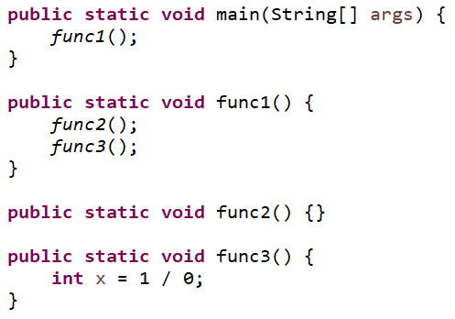
The Stack (briefly)
What about for a less nested structure?
Program execution begins in main Stack: [main]
main calls func1 Stack: [func1, main]
func1 calls func2 Stack: [func2, func1, main]
func2 ends and execution returns to func1 Stack: [func1, main]
func2 calls func3 Stack: [func3, func1, main]

Slide 5




Stack Traces
We can see that the stack allows the program to see the series of calls that led to the current position from main. When the program throws an ArithmeticException in func3:
Nothing explicitly handles the exception in func3, so the program removes func3 from the stack
func1 does the same, and is removed
main does the same, and the program crashes with an error message showing the issue and a stack trace
Stack Trace

Slide 6
Lesson 11: Exceptions and Error Handling
What is really happening here when we see this exception pop up?
Well, the Java programming language has an inbuilt mechanism to work this out for you, called Exception Handling. This allows a program to detect that things are going wrong, and respond by creating a brand new Exception object. In official Java terms, if a program does this, it is throwing an exception. When a program goes wrong, like inputting a double instead of an int, it throws an exception and immediately terminates the block of code running
This is because an Exception object, once it is created, is passed as in a game of hot potato, until a piece of code decides that it wants to catch the exception
Once caught, the catcher does something to save the program from imploding (recovery code), destroys the exception, and moves on as if nothing ever happened
This is done in java using several keywords:
Throw: Creates a specified exception object, and ‘throws’ it
Throws: Passes the buck from a method up to whatever code called the method
Try: Encloses code in a block as an if statement would. Only encloses code that could potentially create an exception
Catch: Block of code that is executed if an exception is generated in the try block of code

Slide 7
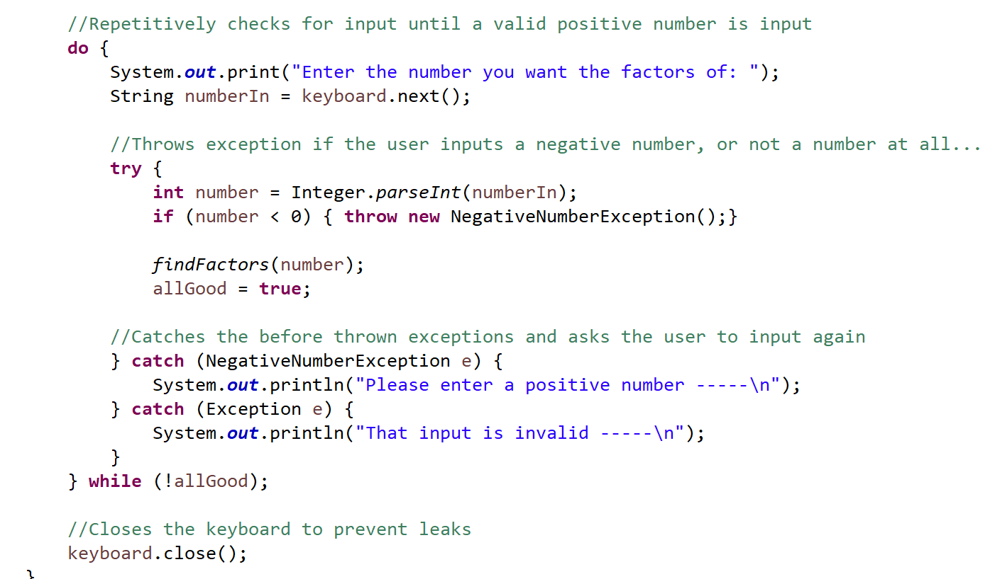
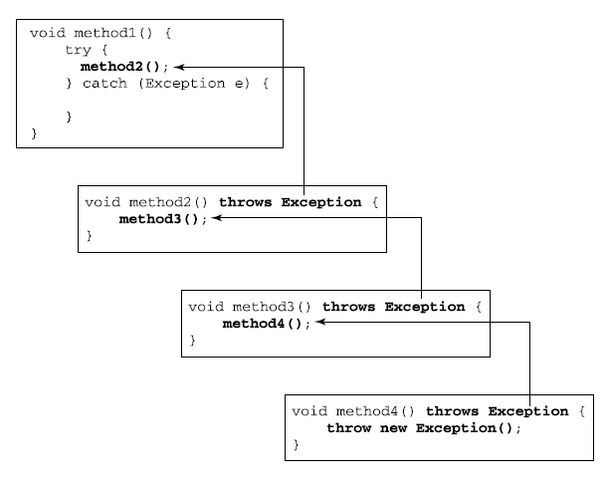
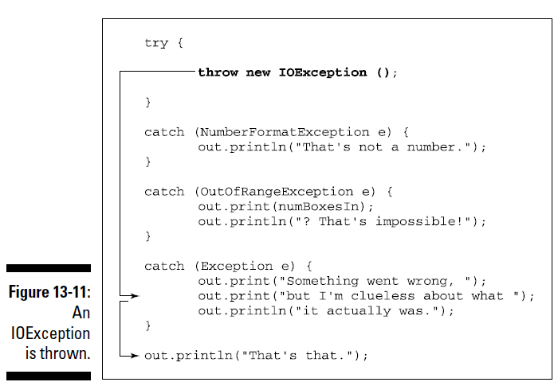
Lesson 13: Exceptions and Error Handling

Slide 8
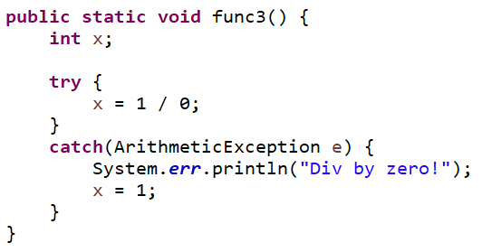
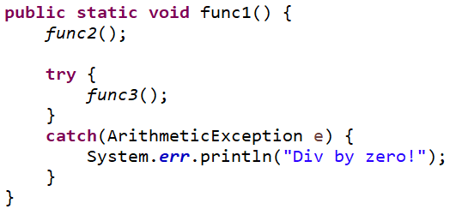
Handling Exceptions
Programs crashing completely whenever an exception is thrown isn’t ideal. Instead, we can ‘catch’ an exception and perform another operation. We have a couple of options:
Catch the exception inside func3, and handle it there
Allow func3 to throw the exception, and catch it further up the stack

Slide 9


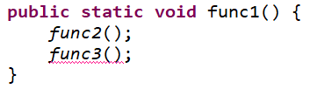
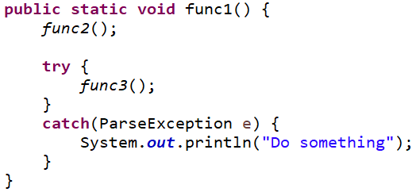
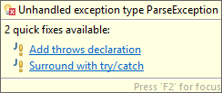
Forcing Exceptions to be Handled
By labelling that a function throws an exception, e.g.
we can force the caller to either enclose the call to the function in a try-catch block, or label itself as throwing the exception for its own caller.
This does NOT apply to subclasses of RuntimeException.

Slide 10
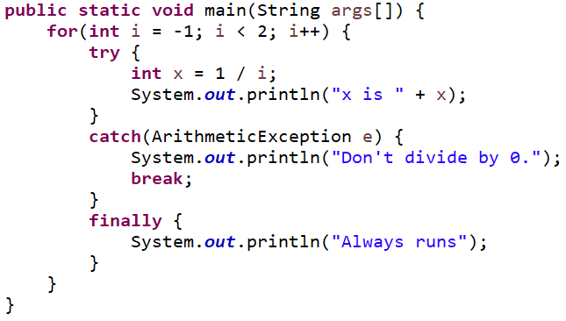

Semantics of try-catch-finally
Consider the operation of the code to the right:
When i = -1:
The try block completes normally
The finally block completes normally
When i = 0:
The try block throws an exception
The catch block catches it and exits the loop
The finally block still executes

Slide 11
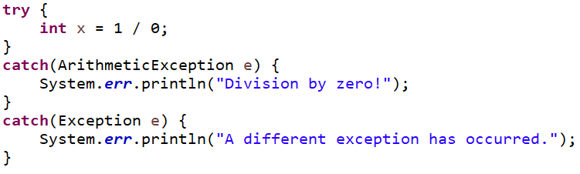
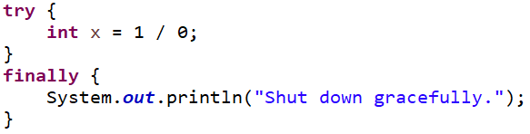

Other Details
Multiple catch blocks can be attached to a try block
0 catch blocks can be attached to a try block, as long as a finally block is attached
The stack trace can be instructed to print, even when caught

Slide 12
Your Turn
Write a program that iterates a value x from -1 to 1 and prints the value of 1 / x if the calculation is valid.
Write a function that takes a string and returns its integer value, printing a helpful error message if the string isn’t an integer. Do NOT catch the generic Exception class.
Notes:
It’s hard to demonstrate the usefulness of exceptions in a small program. The main goal of this exercise is for you to be able to handle them in larger ones.
For part 2, if you don’t know which exception to catch, try crashing the program and examining the output.

Slide 13
Summary
You should now be able to:
Describe what exceptions are
Interpret a stack trace after an exception is left uncaught
Handle basic exceptions in small programs
Identify their use in larger programs
Label thrown exceptions from your own functions
Describe program flow through try-catch-finally blocks
You are NOT expected to be able to:
Generate and throw custom exceptions

